Slide 1

The Future of Data Science in Biotech-Pharma
Jeff Helterbrand
Genentech
BBSW Innovation & Leadership, November 2019

Slide 2
Key Takeaways
Innovation: Data Scientists continue to expand our value - ultimately translating and accelerating scientific advances to benefit patients
Data: Quality FAIR data is the fuel for future new healthcare solutions. Will accelerate the continued ascendency of Data Science.
Leadership: In digital era, excellence in Data Science is now essential – activating Data Science leadership will become even more important going forward (are we ready?)

Slide 3
Data Science
A field that aims to extract knowledge and insights from structured and unstructured data

Slide 4
Notes:
Thalidomide, a new sleeping pill, is found to have caused birth defects in thousands of babies born in Western Europe…aroused public support for stronger drug regulation

Slide 5
Kefauver-Harris Drug Amendments (1962)
Sen. Estes Kefauver
Rep. Oren Harris
For the first time, established a framework that required drug manufacturers to prove scientifically that a medication was not only safe, but effective
Notes:
Thalidomide, a new sleeping pill, is found to have caused birth defects in thousands of babies born in Western Europe…aroused public support for stronger drug regulation

Slide 6
Data Science
Contributions to Biotech-Pharma
Manufacturing
Clinical
Pharmacology
Confirmatory
Clinical Trials (CTs)
1960s 1970s 1980s 1990s 2000s 2010s 2020s

Slide 7
Data Science
Contributions to Biotech-Pharma
Discovery Research
Exploratory CTs
Clinical Practice-
Relevant Data
Health Economics
Portfolio
Manufacturing
Clinical
Pharmacology
Confirmatory
Clinical Trials (CTs)
1960s 1970s 1980s 1990s 2000s 2010s 2020s

Slide 8
Data Science
Contributions to Biotech-Pharma
Post-marketing
Safety
Patient-Reported
Outcomes
Molecular (genomic,
Genetic)
Biomarkers
Globalization
Health Technology
Assessments
Discovery Research
Exploratory CTs
Clinical Practice-
Relevant Data
Health Economics
Portfolio
Manufacturing
Clinical
Pharmacology
Confirmatory
Clinical Trials (CTs)
1960s 1970s 1980s 1990s 2000s 2010s 2020s

Slide 9
Data Science
Contributions to Biotech-Pharma
Real-World Data
Imaging
Digital Tools
Operations, Quality, HR Data
Information Content
Automation
Clinical Decision Support
Integrated Data Marts
Data Sharing
Data Privacy
Post-marketing
Safety
Patient-Reported
Outcomes
Molecular (genomic,
Genetic)
Biomarkers
Globalization
Health Technology
Assessments
Discovery Research
Exploratory CTs
Clinical Practice-
Relevant Data
Health Economics
Portfolio
Manufacturing
Clinical
Pharmacology
Confirmatory
Clinical Trials (CTs)
1960s 1970s 1980s 1990s 2000s 2010s 2020s

Slide 10

The Digital Era
Our healthcare landscape is rapidly transforming with a huge growth in scientific and medical data, which is changing how scientists work.
There are new types of data that are more complex and in higher volumes than ever before.

Slide 11


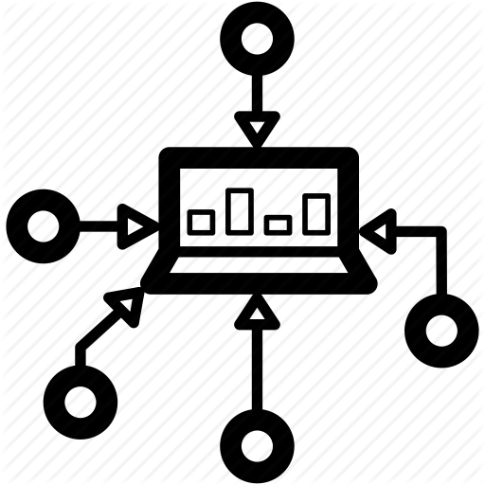





Patient Level Dataset Types
Image Files
e.g. retinal photograph, MRI scan of brain, histopathology
Clinical datasets
Mix of e-CRF and non-CRF data (e.g. biosample results from protocolled test)
Clinical
Integrated Data Mart
Data from different sources and studies harmonized and integrated
Images
Results generated from biosamples
Samples be stored for many years. New results can be generated years after study has closed.
Clinical Trial
Other
Gene Expression
Tumour mutation
Patient
Patient Centered Outcomes
QoL instruments
Digital Device Data
Data generated and results derived from smartphone or smartwatch apps to monitor the patient experience
Omics results
RNA seq, expression data, WES, WGS, FMI Panel etc.

Slide 12
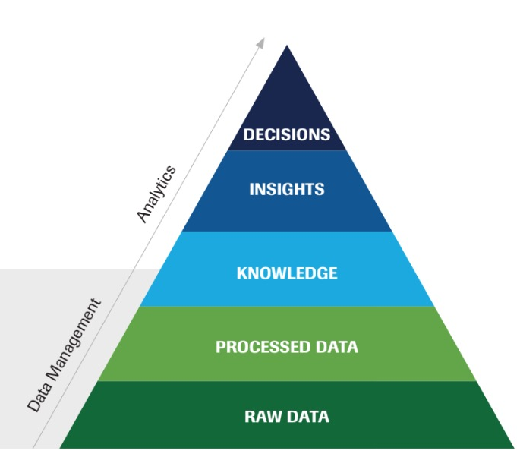




It all starts with FAIR …
Findable
Accessible
Interoperable
Reusable
Notes:
The best machine-learning algorithms and advanced analytics are meaningless if our data is not in order.

Slide 13
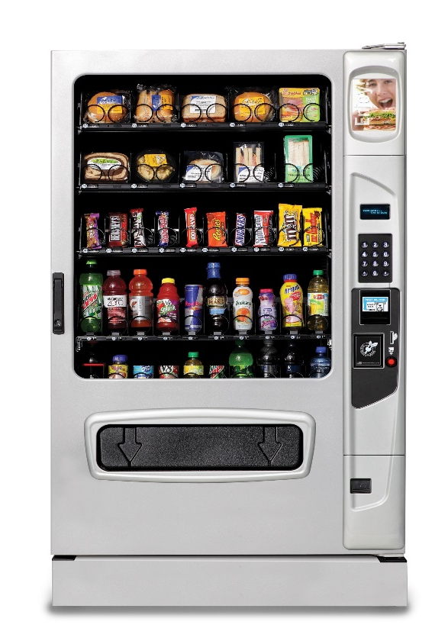
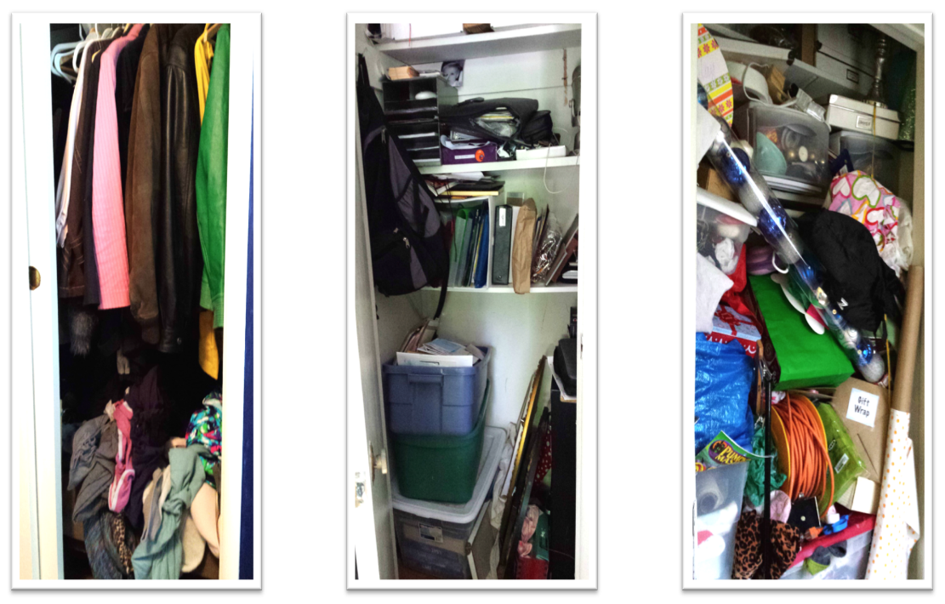
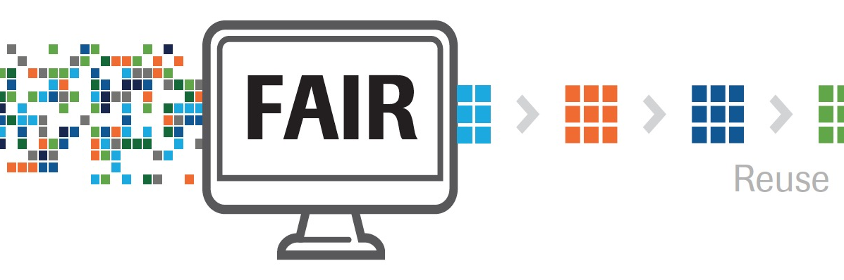

Why should we be FAIR?
Notes:
The way we currently manage data is with study endpoints in mind – somewhat like organizing individual closets (“organized” for study primary end-point use). We put things in where a limited set of people (or person) knows where it is in the moment, but if someone else wanted to find something now or in the future, it would not be easy! This works to answer primary questions in the here and now, but does not make data readily Findable, Accessible, Interoperable, or Reusable for other objectives – filings, PHC, or exploratory research.
What we aim to achieve is something more on the right – a vending machine (organized for maximum use and reuse).
- Easy-to-use catalogs of all available resources.
- Immediate self-service access.*
- Cost to use is obvious.
- Different consumers get consistent results.
- Ingredients on the back, if you don’t mind reading the fine print (e.g., if you want more details, you can get to them, or if you just want to
browse to see what is there, you can do that, too!).

Slide 14



Organized data offers new opportunities
Leveraging potential from new scale and diversity of data types
Personalizing care based on deeper understanding
Expanding data access and findability to generate insights
Enables enhanced
Reverse translation: deepening understanding of diseases
Translational research: developing biomarkers and new endpoints
Predictive modeling: access to new indications, and personalized healthcare solutions
Notes:
…when we can fully leverage the potential from the digitization of healthcare for generating insights to discover new medicines and to develop them in a more effective way.
…when we can start to offer our patients more personalized treatments based on who they are and their disease.
137,00 patients…

Slide 15

The Reign of Data is Beginning where rapid data-driven insights and automating manual processes becomes essential*
EDIS/RSI
Research Science
Medical Science
Data Science
* Deloitte (2018), Unlocking R&D Productivity, Measuring the return from pharmaceutical innovation 2018

Slide 16

Being Ready to Step Up to Lead
Data Science Leadership
Quality data sources
Platforms
Data and Information Pipelines
Analytical methods
Technology
Drug Development Leadership
Molecule Team Leaders
Disease Area Leaders
Enterprise Leaders

Slide 17



Essential Ingredients for the Future
Effective and Flexible Drug Development Data Ecosystem – from data creation/acquisition through interpretation/communication; from infrastructure/tools/automation through security/data lifecycle management
Creating environments where Data Scientists will thrive – in high demand in many industries, academia, government
Enable Data Scientists to best work with rest of business for maximal value – requires data scientists to be more influential; requires increasing “data knowledge” of non data scientists

Slide 19
Key Takeaways
Innovation: Data Scientists continue to expand our value - ultimately translating and accelerating scientific advances to benefit patients
Data: Quality FAIR data is the fuel for future new healthcare solutions. Will accelerate the continued ascendency of Data Science.
Leadership: In digital era, excellence in Data Science is now essential – activating Data Science leadership will become even more important going forward (are we ready?)

Slide 20
Doing now what patients need next

Slide 21
What is “Success”?
Maximizing impact you can have on company and our constituents
Increasing breadth and diversity of experiences you can choose to have in your career

Slide 22
Keys to Success
All tips focus on the following must-haves:
Personal motivation (sense of purpose)
Developing and maintaining credibility
Building capabilities to influence

Slide 23
10 Tips for Success
Act as if you are running your own business
Demonstrate intellectual curiosity of a scientist
Build trust and open lines of communication
Demonstrate ability to consider multiple options and recognize trade-offs (seek context/think broadly)
Get comfortable with ambiguity and change (and adapt)
Make (realistic) commitments on your terms & then follow through
Know routinely asked questions during internal/external reviews
Think in terms of your audience & present your headline responses at the right level (Influence)
Do not misrepresent your certainty
Leverage your manager/look for mentors

